Slide 1




Weather Email Report
Team TheBestDoods: Curren Marcello, Joshua May, Patrick Rokos, Elmer McElmeel
Notes:
Patrick

Slide 2



Our goal
Our goal was to make an automatic weather informant that sends the user detailed information about selected cities and compares those cities using graphics of dataframes and barcharts all to their personal or prefered email. That makes it easy for the user to compare the several locations that they choose from side by side.
Notes:
Patrick

Slide 3

The challenges we faced
We found that the scope of our project was unreasonable based off our timeframe.
These included:
In order to achieve our goal of having a different our code display a series of the past 7 days of weather, we would have had to have had the code completed around the start of the project to record the days.
Having the code run automatically everyday and send the weather information without the user having to go in and run the code is out of the scope of what we covered in this class.
This resulted in us having to alter our project to displaying different locations current weather data in the email.

Slide 4
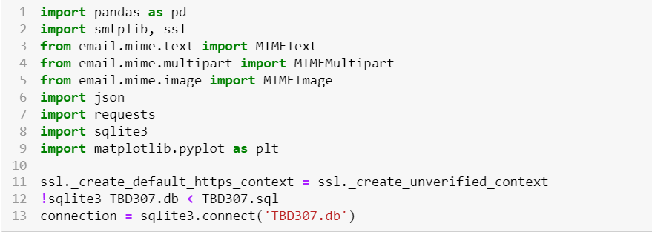
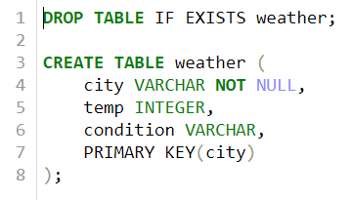
How we did it
Our SQL file:
Imports and connection
to SQL database:

Slide 5
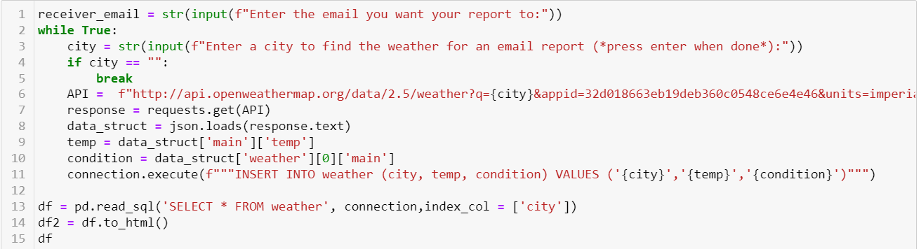
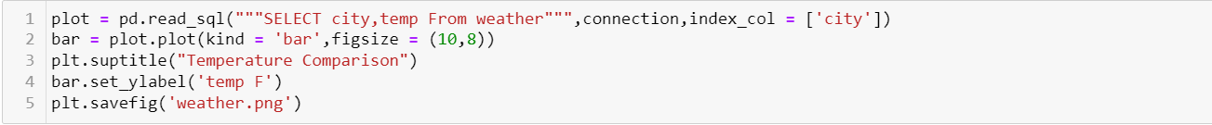
How we did it cont…
We accessed openweathermap weather API to get the data of the current weather in our locations, and asked for user inputs
Here we created a bar plot from from by reading our sql file, we then saved it locally as a png.

Slide 6
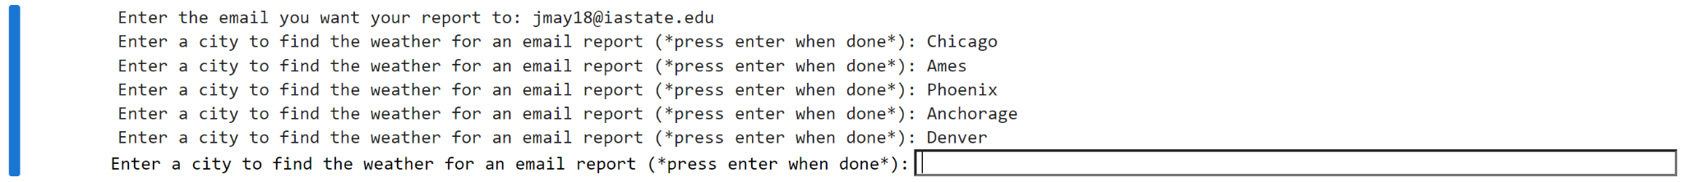
How we did it cont…
This is an example of the code running…

Slide 7
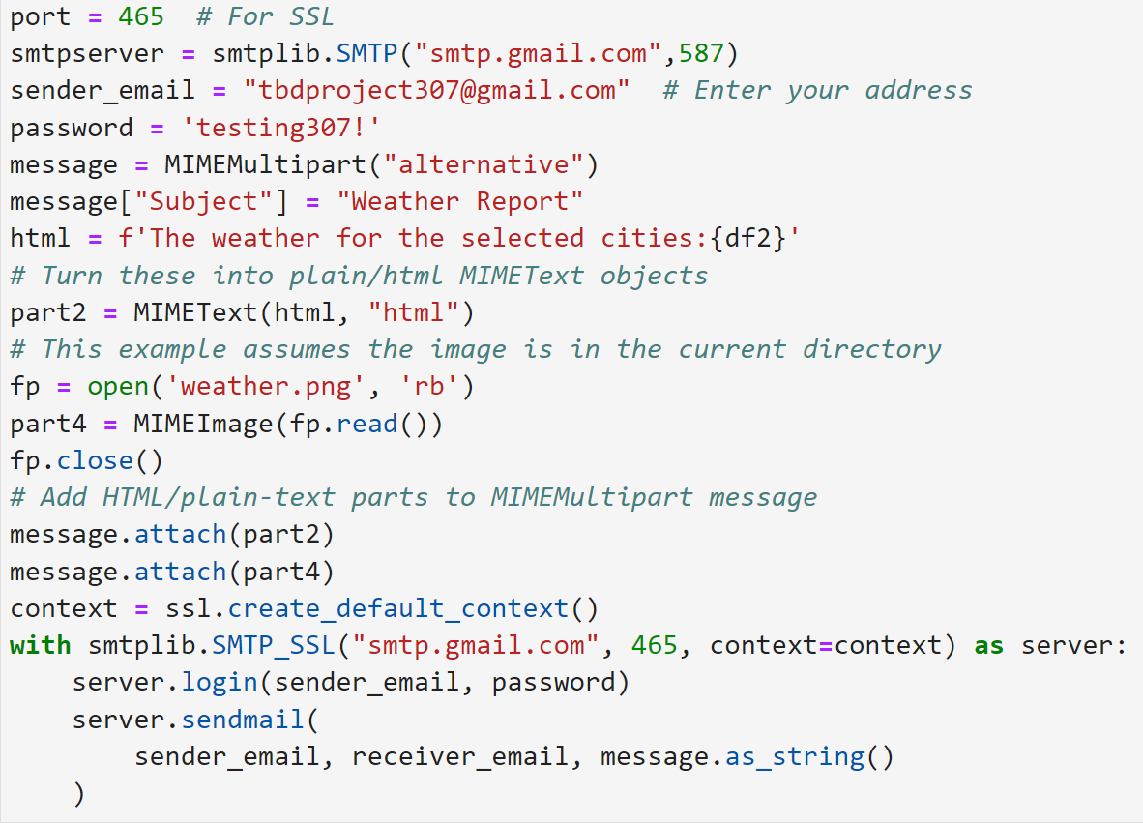
How we did it cont…
Finally, we connected to gmail using pythons smtplib. Here we added the subject of our email, a test intro, and then the dataframe as an html.

Slide 8
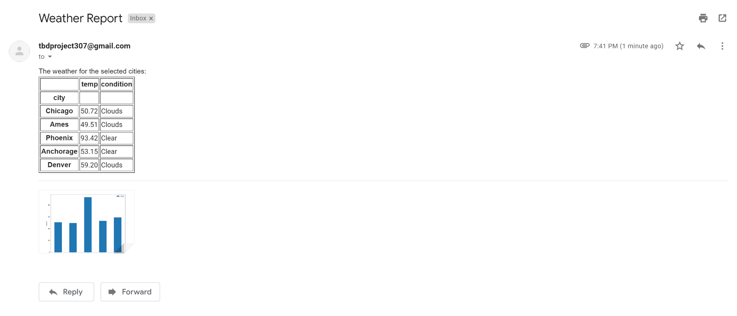
Email results
Here is an example of how the email would look being received in the mail and what it looks like once the user opens the email.
Notes:
Curren

Slide 9
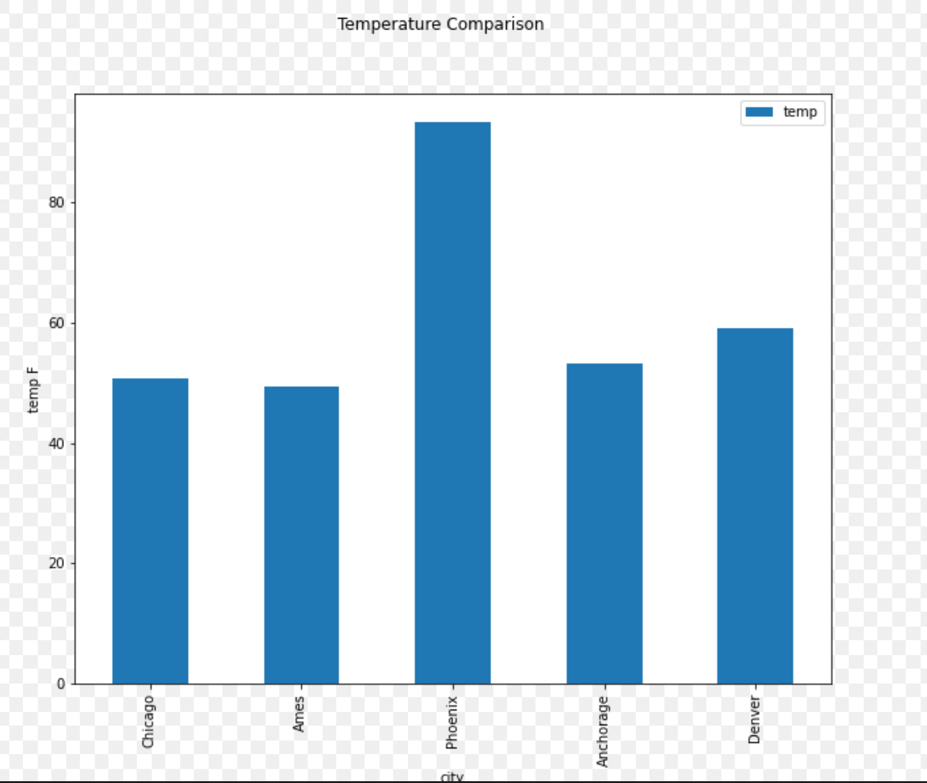
Barchart results
Here we have an example of what our Barchart looks like once you open the email.
Notes:
Curren

Slide 10

What we learned
“Restart the Kernel”
Overcoming Scope Creep and Obstacles
New imports, packages, and code…
SMTPLib, email.mime
Collaborating on a single Notebook
Notes:
Curren

